Slide 1
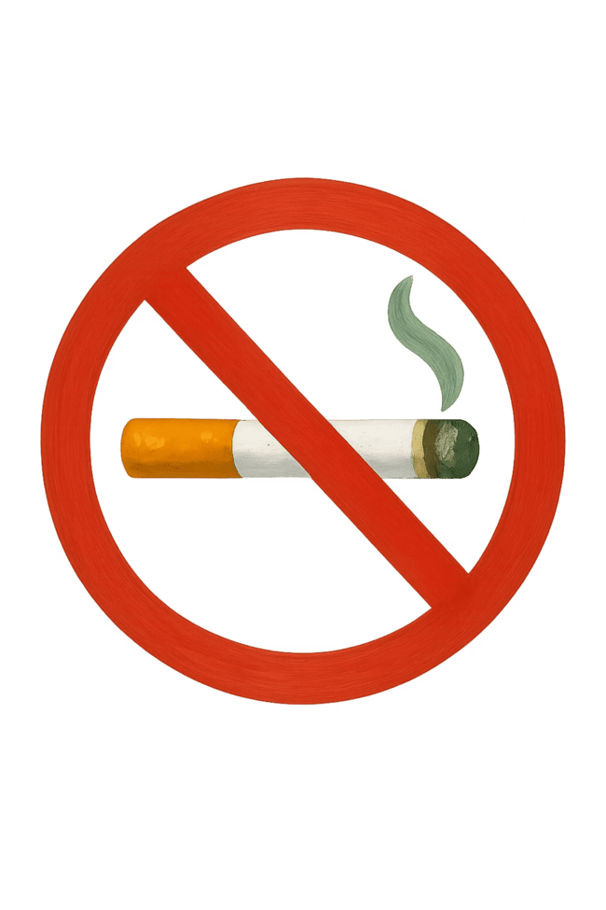
Tobacco Awareness
Presented by:
Mohammed Karimul Mowla
Md Ariful Islam

Slide 2

Introduction
Tobacco use is a major problem among young people. Many students want to quit but they do not get proper guidance or motivation.This mobile app will help users quit tobacco through daily plans, motivation, tracking, and support.

Slide 3

Problem Statement
Many users fail to quit tobacco because:
They do not know their addiction level
They do not follow a proper quit plan
They lack motivation and reminders
They do not have support during cravings
This project aims to solve these problems through a simple and structured mobile app.

Slide 4
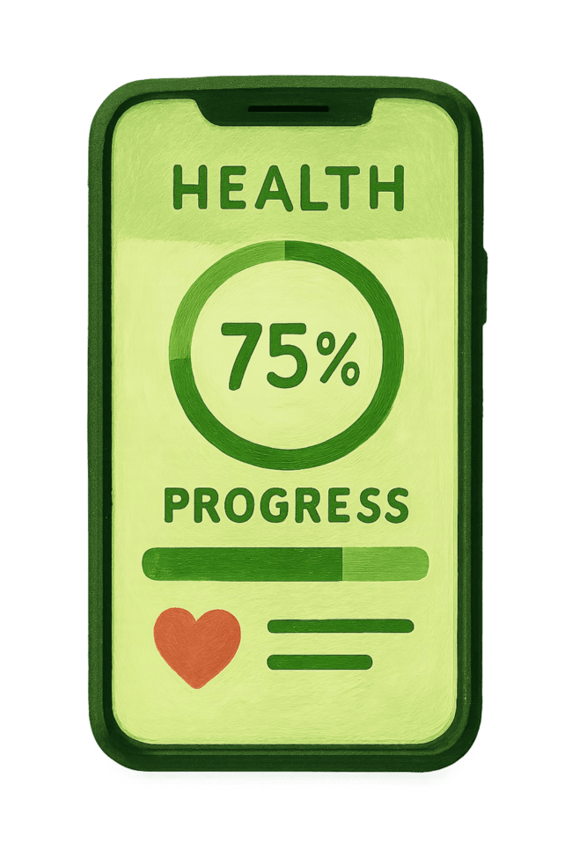
Project objective
To help users understand their tobacco use and addiction level
To provide a personalized quit plan with daily tasks
To support users with reminders, educational content, and peer help
To track progress in health, cravings, and money savings

Slide 5
Proposed Solution
We are building a user-friendly mobile app that guides the user step-by-step to quit tobacco.The app will generate quit plans, send motivational notifications, track health recovery, show money savings, and provide peer support.

Slide 6
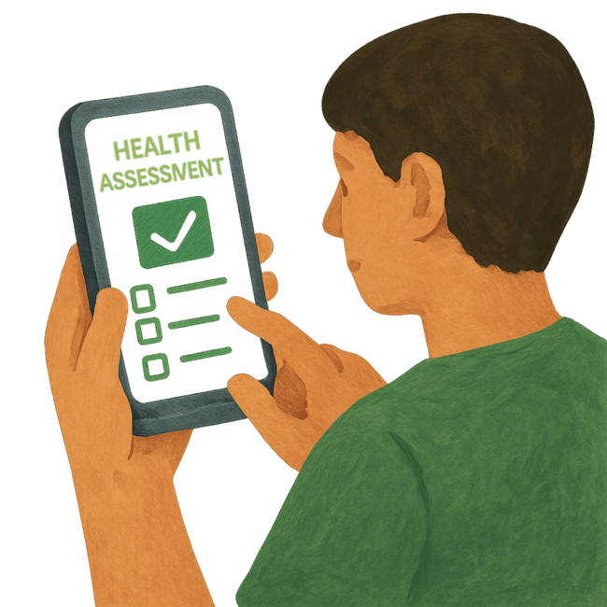
Key Feature 1 : User profile & assessment
Age, gender, institution
Tobacco type (smoking/smokeless)
Nicotine dependence test
Readiness-to-quit stage
Set a personalized quit date

Slide 7
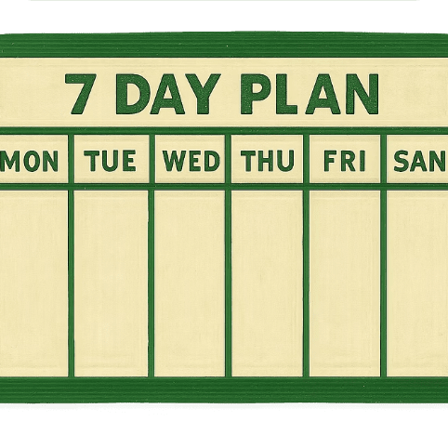
Key Feature 2 : Quit plan generator
Personalized quit roadmap (7 / 14 / 30 days)
Daily micro-goals (e.g., “Delay first cigarette by 30 min”)
Trigger identification (stress, friends, after meals)

Slide 8
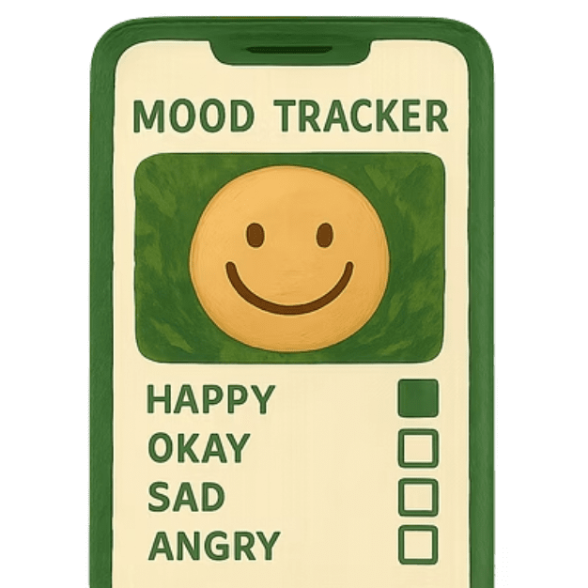
Key Feature 3 : Daily check-in & progress
Did you use tobacco today? (Yes/No)
Craving intensity scale (1–10)
Mood tracker (stress, anxiety, boredom)
Quick reflection: “What triggered you today?”

Slide 9
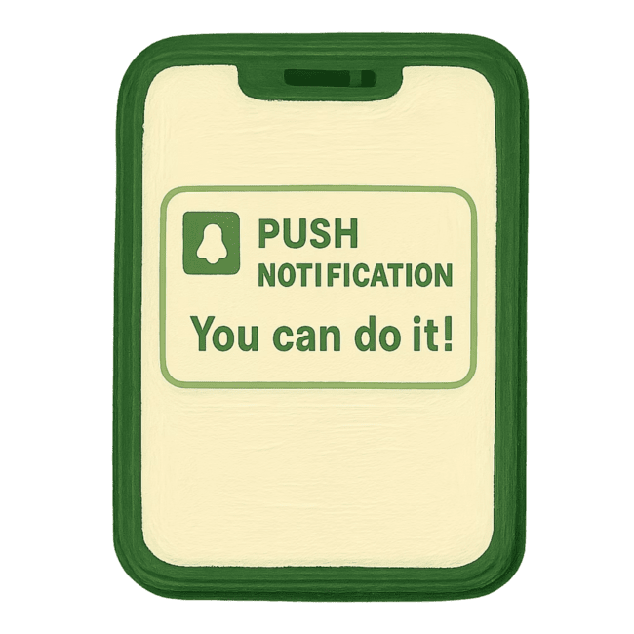
Key Feature 4 : Notifications & motivational system
Motivational messages
Reminder alerts
Craving-time notifications

Slide 10
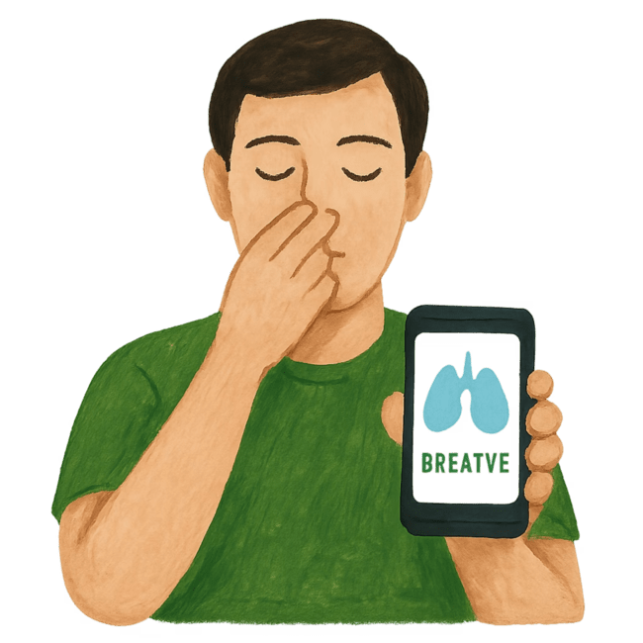



Key Feature 5 : SOS-Immediate craving support
5-minute survival timer
A strong urge to smoke lasts only 5 minutes. Hold on until the timer hits zero.
Breathing exercise
Inhale through your nose for 4 seconds.
Hold your breath for 7 seconds.
Exhale slowly through your mouth for 8 seconds.
Quick distractions
Drink a glass of cold water.
Do 10 jumping jacks (exercise).
Count backward from 100 by subtracting 7 (100, 93, 86...).

Slide 11
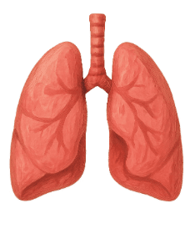


Key Feature 6 : Educational Modules
Social pressure handling
Health effects of tobacco
Myths vs facts

Slide 12
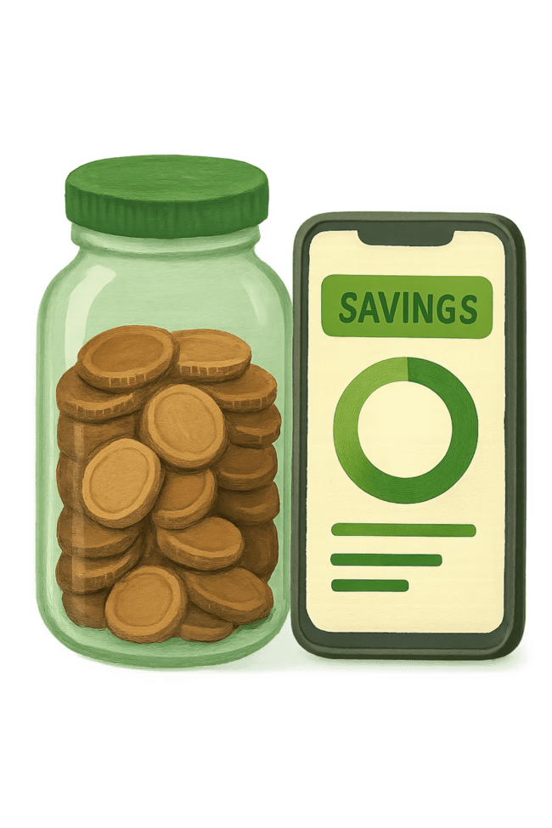
Key Feature 7 : Money Saver Tracker
For young people, saving money is a big factor. This section shows what they can buy by quitting smoking.
Savings Calculator: "Today you saved _______ Taka, which would have been spent on cigarettes.“
Wishlist Goal: "What do you want to buy with your saved money?“
Progress Bar: "Congratulations! You are 60% of the way toward buying your dream gadget!"

Slide 13

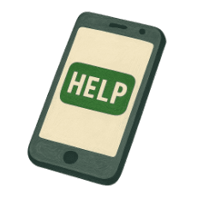
Key Feature 8 : Peer Support System
Group chat (moderated)
Peer counselor messaging
Anonymous Q&A option
“Ask for help now” button

Slide 14




Key Feature 9 : Gamification System
XP points system
daily check-ins
attending peer sessions
resisting cravings
Levels
Beginner → Warrior → Smoke-free Champion
Badges & achievements
“24-hour smoke-free”
“First craving defeated”
“7-day streak”

Slide 15
Target Users
Teenagers and young adults
College and university students
Anyone trying to quit smoking
Health awareness volunteers

Slide 16
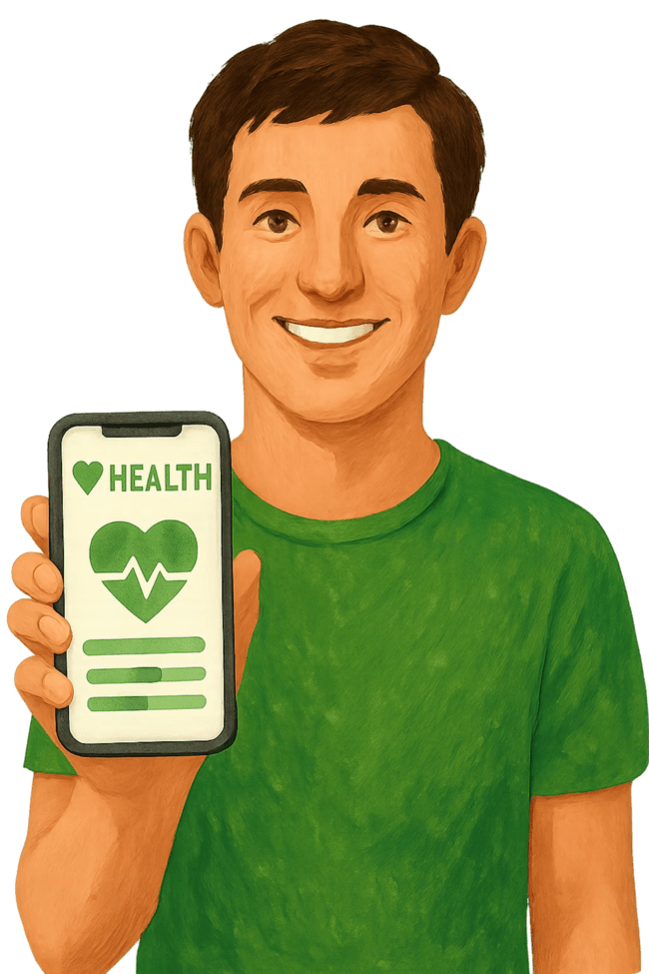
Benefits
Helps users quit tobacco in a structured and scientific way
Provides daily motivation
Emotional support from peers
Shows health improvements
Shows how much money the user saves
Builds long-term healthy habits

Slide 17
Development Methodology
Methodology: Agile
Sprint Plan:
Sprint 1: Requirements + UI sketches
Sprint 2: Profile + Quit Plan module
Sprint 3: Daily check-in + Notifications
Sprint 4: Money + Health tracking
Sprint 5: Peer chat + Gamification
Sprint 6: Testing & final improvement

Slide 18
Work Plan
Phase 1: Requirement Analysis
Phase 2: UI/UX and System Design
Phase 3: App Development (Frontend + Backend)
Phase 4: Testing & Bug Fixing
Phase 5: Final Submission and Presentation

Slide 19
Expected Outcome
At the end of the project, we expect to deliver:
A fully functional mobile app
User-friendly quit assistance system
Daily habit trackingPeer support communication
Motivational and educational tools
Complete documentation

Slide 20
Limitations & Risks
Limited development time
Some features are technically complex
Real-time chat dependency on internet

Slide 21
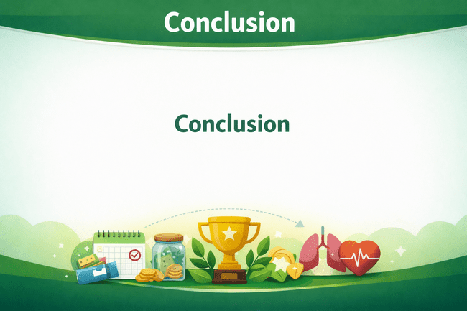
This project will help users quit tobacco using a supportive mobile-based system.It will create positive health outcomes, reduce tobacco use, and motivate young people toward a healthier lifestyle.The app combines technology, behavior change, and community support.

